Slide 1
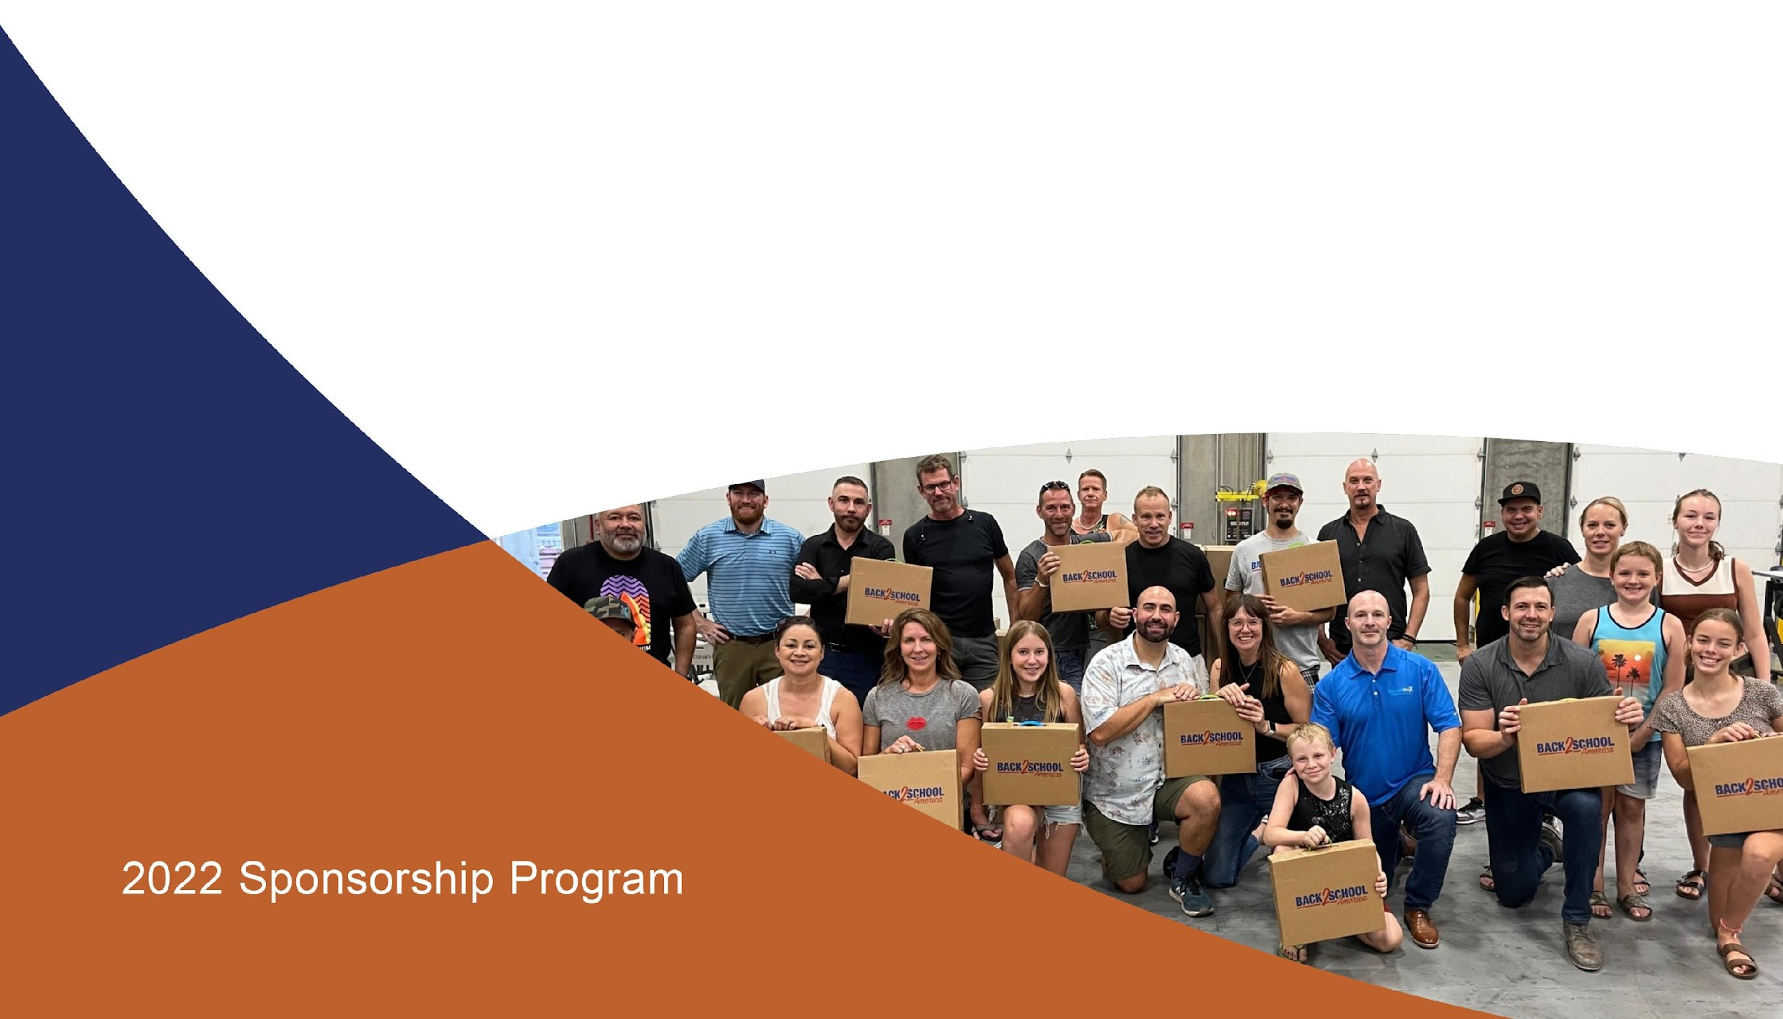
Phoenix Build-A-Kit
Notes:
1

Slide 2
PROGRAM OVERVIEW
Back 2 School America
In 2021, American families continued to struggle. Schools lacked funds and too many parents couldn’t afford to buy even basic school supplies for their kids. The impact of COVID-19 dramatically increased need across the state. Since 2007, the Back 2 School Program has sent more than 300,000 needy children back to school with the tools they need to succeed in the classroom. In 2022, our goal is to distribute a record number of our signature Back 2 School kits to help even more children — so we need your generous support!
WHO DO WE REACH?
We reach low-income families throughout the country through a myriad of partnerships with schools, community organizations and government agencies. These include YMCAs, Operation Homefront (serving military families), Heartland Alliance, YWCA’s, United African Organization and many others.
ILLINOIS’ LARGEST FREE SCHOOL SUPPLY INITIATIVE
Our Back 2 School program is a year-round initiative to provide children with school supplies in the form of grade-appropriate Back 2 School kits. Each kit contains approximately 30 vital school supplies. The bulk of our Back 2 School kits are given out during a series of distribution events. Our kits have a positive effect on a child’s classroom performance as well as their self-esteem. Our program also reduces the financial burden on parents, as well as teachers, who often reach into their own pockets to pay for school supplies for their students.
With our expanding support base, the 2022 program will be our best ever. By becoming a stakeholder, you and your company will not only be helping a very worthwhile cause but will also receive positive exposure as well. We hope you will consider joining our program or continuing your support. With over 30 million children in America who come from families that can’t afford to buy even basic school supplies, we have a long way to go, but together we can make it happen.
Notes:
2

Slide 3
Phoenix Build-A-Kit & Distribution Event
EVENT ELEMENTS
Date: July 21, 2022 Time: 5:00 pm – 9:00 pm Locations: InteriorWorx Commercial Flooring 2040 W. Rio Salado Pkwy, Tempe, AZ 85281
Details:* • Volunteers assemble Back 2 School kits
• Volunteers write “Notes of Inspiration” (notes are inserted into kits and further help to boost the self-esteem of the recipients)
• Kits assembled at the event will be distributed to children from low-income families in the Phoenix metro area
• Food and Beverages will be provided

Slide 4
Back 2 School America
SPONSORSHIP LEVELS
Phoenix Build-A-Kit | Titanium | Gold | Silver | Bronze
Amount: | $18,000 | 9,000 | $4,500 | $2,250
SPONSORSHIP LEVELS
Logo/Name Printed on Kit Box Sticker & Shipping Cartons | Large | Medium | Small | Type Only
Social Website Presence on Event Page | X | X | X | X
Social Media Mentions | 4 | 3 | 2 | 1
Listed on Press Release Media Alert | X | X | X | X
Logo/Name Printed on Event Banner | Large | Medium | Small | Type Only
Logo/Name Printed on Event T-shirt | Large | Medium | Small | Type Only
Featured in Monthly E- Newsletter Story | 2 | 1 | 1 | 1
Ability to have Company Materials Inserted into Kits | X | X
Ability to Distribute Information to Volunteers | X | X
Ability to Select Organization to Receive Kits | X | X

Slide 5
Back 2 School America
2022 PROGRAM SPONSORSHIP
Since inception, the Back 2 School program has provided over 9 million free school supplies to children of low-income households and lessening the financial burden for their families. With your support, Back 2 School America can continue to help level the playing field and make sure that all children have the opportunity to get a first-rate education and go on to become healthy, happy, productive members of our society.
___________________________________________________________________
For more information on sponsorship, please contact CEO, Matthew Kurtzman 312.848.5551 or MatthewKurtzman@B2SI.org
Back 2 School America’s mission is to create and support educational opportunities that enrich the lives of children across the USA.
Back 2 School America is a 501c3 nonprofit. EIN 27-2492956
___________________________________________________

